Slide 1
Building an Inclusive Community for Neurodivergent Students: A Grassroots Approach
Tara Chandrasekhar, MD
Duke University

Slide 2
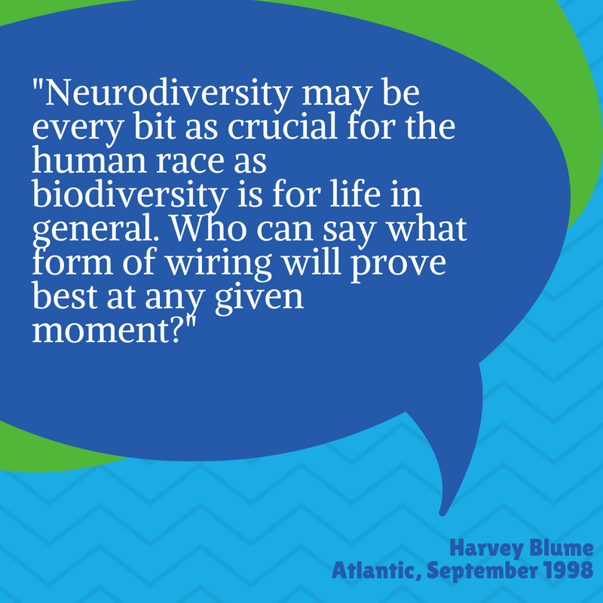
Agenda
How it Started
How it’s Going
What’s Next?

Slide 3
Neurodiversity at Duke
Notes:
NDC grew out of a need to improve the experience of neurodivergent Duke students– grass roots. Focused on academic and co-curricular aspects of life as a student.
Presentations, awareness events, student group, career fair.
Still so much work to do!!

Slide 4
Engaging Key Stakeholders
Students
Mental/
Physical Health Services
Career Services
Disability Services
Case Management
Faculty
Deans
Student Groups
EDI leaders
Parents
Alumni
Notes:
Important to determine how to best engage stakeholders– what is their role in this work? What is reasonable to ask people to do given the grassroots nature? How do you sustain momentum when stressful things (e.g. COVID) occurs?

Slide 5
How It’s Going…
17 offices engaged
30+ outreach presentations
4 campus wide events
2 career summits
Presentations at conferences, 2 publications

Slide 6
Student Leadership is Key
Consider how best to engage students
Value of student perspectives and feedback
Focus groups
Surveys
Panel discussion
Contributions to website content (resources, language)
Notes:
student

Slide 7
Campus Presentations
Don’t underestimate the power of students
“Neurodiversity 101” is useful– slides ready to go
Build a core team of presenters
Offer concrete tips to faculty/staff

Slide 8
Build a Resource Library
Website (library, events)
Tip sheets
Videos

Slide 9
What about Funding???
Internal and External Grants
Sponsorships
Alumni gifts
Volunteering vs. incorporating into current roles

Slide 10
Leveraging Relationships Across Duke
Institutional Neurodiversity Initiative
Engagement with health system
Duke Autism Center Neurodiversity taskforce

Slide 11
Ongoing Questions
How to move beyond “one and done” trainings
How to assess the true impact of the work
How to ensure the work is sustainable as leaders come and go
How to better engage alumni

